Slide 1
Advanced Angular
Authentication and Authorization
Lecture 9
By James(Jin) Wang
11/15/2021

Slide 2
Outline
JSON Web Tokens (JWT)
Stateless authentication
Protect routes
Redirect the users to a ”login” or “access denied” page
Show/hide elements
Get the current user
Consumer protected API endpoints

Slide 3
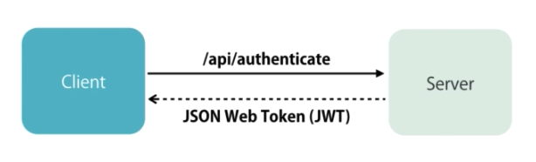
JSON Web Tokens
  Authentication:

Slide 4
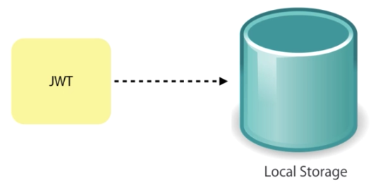
JSON Web Tokens
  Persisting a JWT:

Slide 5
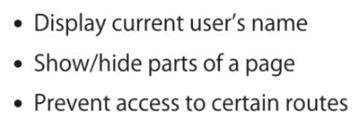
JSON Web Tokens
  JWT on the client:

Slide 6
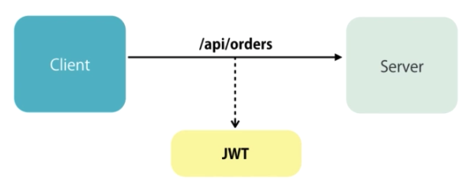
JSON Web Tokens
  Authorization:

Slide 7
JSON Web Tokens
  Authorization:
  https://jwt.io/
  Libraries
  Debugger

Slide 8
JSON Web Tokens
  Implementing Login and Logout:
  Demo: Implement Login and Logout

Slide 9
JSON Web Tokens
  Showing or Hiding Elements:
  Demo: Showing or hiding elments

Slide 10
Summary

Slide 11
Assignment
  1. Implement the routing for a blogging engine.

Slide 12
Self Study
  Angular: Getting Started
  https://app.pluralsight.com/library/courses/angular-2-getting-started-update
  Angular Routing
  https://app.pluralsight.com/library/courses/angular-routing

